Slide 1

SMS SPAM CLASSIFICATION USING NLP
Authors: T. Jain, P. Garg, N. Chalil, A. Sinha, V. K. Verma and R. Gupta

Slide 2
Motivation
In the digital age, the proliferation of spam messages poses significant challenges to individual productivity and security. Leveraging Natural Language Processing (NLP) techniques for spam message classification not only enhances our ability to filter out irrelevant and potentially harmful content efficiently but also improves user experience by ensuring that vital communications reach their intended recipients without delay. By applying NLP, we can automate and refine the detection of spam, adapting to evolving tactics used by spammers and protecting users from unwanted intrusions into their digital communications.

Slide 3
Objectives
Removing special character and numbers using regular expression
Converting the entire sms into lower case
Tokenizing the sms by words
Removing the stop words
Lemmatizing the words
Joining the lemmatized words
Building a corpus of messages

Slide 4
Related Work
Proposed a transfer learning approach for SMS spam detection using Naïve Bayes classifier. The researchers utilized data augmentation methods to expand the training dataset and improve the classifier’s performance. They also applied stacking, a model ensemble technique, to combine multiple classifiers for enhanced spam detection accuracy. The experiments conducted on a real-world SMS dataset demonstrated the efficacy of the proposed approach in achieving improved performance compared to traditional Naïve Bayes classifiers. The study contributes to the area of SMS spam detection by introducing a transfer learning framework that leverages augmentation and stacking techniques for enhanced classification accuracy.

Slide 5
Critical Analysis
Strengths:
The abstract clearly outlines the motivation for the study, highlighting the ubiquity of mobile phones and the corresponding increase in spam communications.
The introduction provides a comprehensive background on the issue of SMS spam, emphasizing the necessity for effective spam detection mechanisms.
Weaknesses:
While the motivation is well-articulated, the abstract could benefit from a more concise summary of the key results and their implications.
Some of the objectives, such as the repeated mention of removing special characters and numbers, could be consolidated for clarity.

Slide 6
Problem Statement
The increasing volume and sophistication of spam messages circulating through digital communication channels present significant challenges in maintaining the efficiency, privacy, and security of online interactions. This project aims to develop a robust spam detection system using advanced Natural Language Processing techniques and machine learning algorithms, specifically Random Forest classifiers, to accurately identify and filter out spam messages. By leveraging feature extraction and employing an automated classification model, the system will enhance the ability to protect users from unsolicited and potentially harmful content, thereby ensuring the integrity and reliability of digital communications.

Slide 7
Proposed Solution
Collection of Dataset from Kaggle
Data Analysis
Feature Engineering
Data Cleaning
Model Building & Comparision
Making Predections

Slide 8
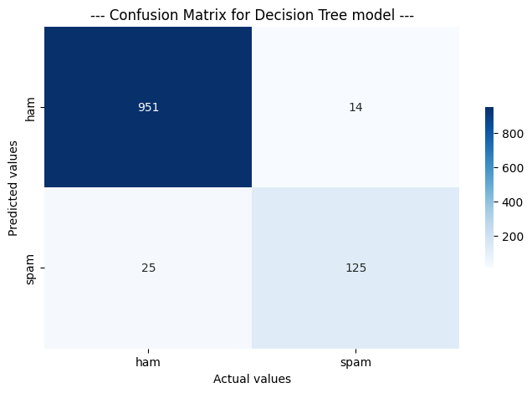


Proposed Solution

Slide 9
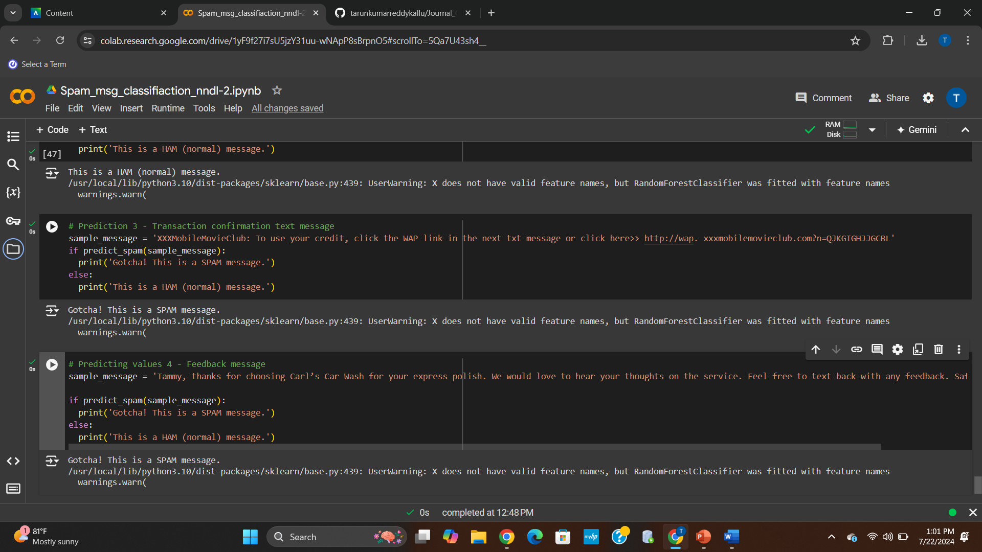
Results

Slide 10
References
T. Jain, P. Garg, N. Chalil, A. Sinha, V. K. Verma and R. Gupta, "SMS Spam Classification Using Machine Learning Techniques," 2022 12th International Conference on Cloud Computing, Data Science & Engineering (Confluence), Noida, India, 2022, pp. 273-279, doi: 10.1109/Confluence52989.2022.9734128. keywords: {Support vector machines;Machine learning algorithms;Costs;Machine learning;Probability;Message service;Natural language processing;Spam detection;SMS spam;machine learning},
S. V P, V. V, K. R and T. T. T, "Performance Comparison of Machine Learning Algorithms in Short Message Service Spam Classification," 2023 2nd International Conference on Advancements in Electrical, Electronics, Communication, Computing and Automation (ICAECA), Coimbatore, India, 2023, pp. 1-4, doi: 10.1109/ICAECA56562.2023.10199265. keywords: {Support vector machines;Training;Logistic regression;Machine learning algorithms;Forestry;Filtering algorithms;Message services;SMS spam detection;spam filtering;machine learning;random forest;classification},
A. Kumar and C. Fancy, "Enhancing Security in SMS by Combining NLP Models Using Ensemble Learning for Spam Detection with Image Steganography Integration," 2023 2nd International Conference on Edge Computing and Applications (ICECAA), Namakkal, India, 2023, pp. 583-586, doi: 10.1109/ICECAA58104.2023.10212103. keywords: {Support vector machines;Steganography;Machine learning algorithms;Computational modeling;Receivers;Feature extraction;Natural language processing;Natural Language Processing;Ensemble Learning;Spam Detection;Image Steganography},
P. Joseph and S. Y. Yerima, "A comparative study of word embedding techniques for SMS spam detection," 2022 14th International Conference on Computational Intelligence and Communication Networks (CICN), Al-Khobar, Saudi Arabia, 2022, pp. 149-155, doi: 10.1109/CICN56167.2022.10008245. keywords: {Support vector machines;Unsolicited e-mail;Digital communication;Communication networks;Organizational aspects;Random forests;Computational intelligence;Spam detection;machine learning;word embedding;bag-of-words;term frequency-inverse document frequency;n-grams;word2vec;doc2vec},
K. Debnath and N. Kar, "Email Spam Detection using Deep Learning Approach," 2022 International Conference on Machine Learning, Big Data, Cloud and Parallel Computing (COM-IT-CON), Faridabad, India, 2022, pp. 37-41, doi: 10.1109/COM-IT-CON54601.2022.9850588. keywords: {Deep learning;Support vector machines;Radio frequency;Unsolicited e-mail;Computational modeling;Bit error rate;Data preprocessing;Email Spam detection;Deep Learning;Machine Learning;LSTM;BERT},

Slide 11
Thank You ☺
Name: Tarun Kumar Reddy Kallu
Student Id: 700758234

